Slide 1


Artificial Intelligence Course Code: CSE4019
Winter Semester
(2025-26)
by
Dr. Edara Sreenivasa Reddy
Professor,-HAG,
SCOPE, VIT-AP University, India
1

Slide 2
Artificial Intelligence
Course Code: CSE4019
Slot: A1/A2
Module-1 Information
2

Slide 3

Intelligent Agents

Slide 4


AI Architecture
Real World
Agent
Sensors
Model of World (being updated)
Prior Knowledge about the World
Reasoning & Decisions Making
Effectors
List of Possible Actions
Goals/Utility

Slide 5
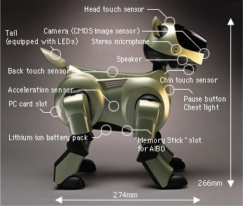


Sony AIBO
http://www.aibo.com

Slide 6
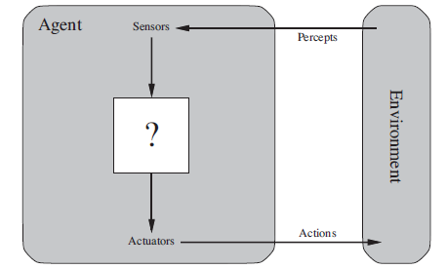
Agents and environments
Agent: perceives environment, using sensors, acting on environment with actuators
Agent examples: robots, softbots, thermostats…
Percept: agent’s perceptual inputs at any given instant
Historically, AI has focussed on isolated components of agents--now, looking at whole thing

Slide 7
…agents
Sensors receive : camera and video images, keyboard input, file contents, …
Actuators act on environment by: robotic arm moving things, softbot displaying on screen/writing files/sending network packets…
General assumption: every agent can perceive its own actions, but possibly not its effects

Slide 8
…agents
Agent function: maps any given percept sequence to an action (an abstract mathematical formula)
Agent’s choice of action depends on percept sequence observed to date
Imagine tabulating the agent function: table will be an external characterization of the agent
Internally, agent function will be implemented by an agent program (a concrete implementation of the agent function)

Slide 9
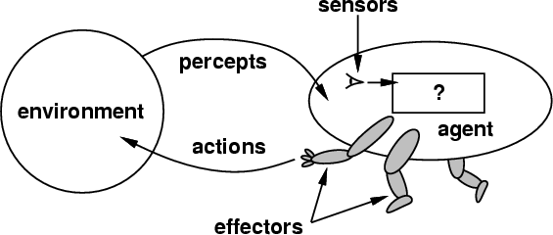
How do you design an intelligent agent?
Definition: An intelligent agent perceives its environment via sensors and acts rationally upon that environment with its effectors.
A discrete agent receives percepts one at a time, and maps this percept sequence to a sequence of discrete actions.
Properties
Autonomous
Reactive to the environment
Pro-active (goal-directed)
Interacts with other agents
via the environment

Slide 10
What do you mean, sensors/percepts and effectors/actions?
Humans
Sensors: Eyes (vision), ears (hearing), skin (touch), tongue (gustation), nose (olfaction), neuromuscular system (proprioception)
Percepts:
At the lowest level – electrical signals from these sensors
After preprocessing – objects in the visual field (location, textures, colors, …), auditory streams (pitch, loudness, direction), …
Effectors: limbs, digits, eyes, tongue, …
Actions: lift a finger, turn left, walk, run, carry an object, …
The Point: percepts and actions need to be carefully defined, possibly at different levels of abstraction

Slide 11





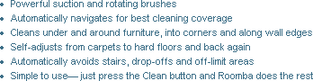
E.g., vacuum-cleaner world
Agent / Robot
iRobot Corporation
Percepts: location and contents, e.g., [A, Dirty]
Founder Rodney Brooks (MIT)
Actions: Left, Right, Suck, NoOp

Slide 12
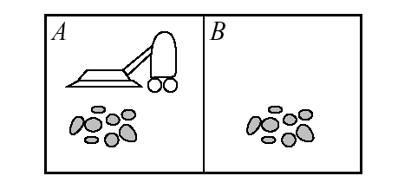
Vacuum cleaner world
2 locations: square A, square B
Agent perceives location and contents (dirty/not dirty)
Actions: left, right, suck, no_op

Slide 13
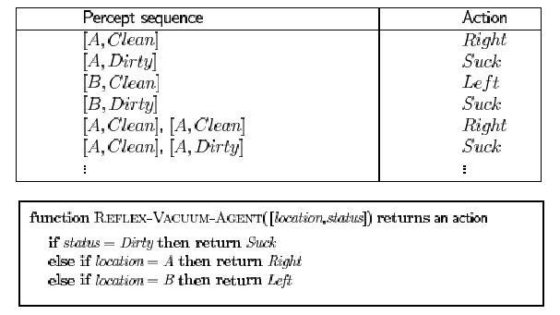
A vacuum cleaner agent
What’s the ‘right’ way to fill out the table?
‘Right’ way makes agent good/intelligent

Slide 14
Rationality
“Do the right thing”, or more formally:
“A rational agent is one that acts so as to achieve the best outcome or, when there is uncertainty, the best expected outcome.”
Need to as questions:
What do we mean by ‘best’?
What’s the outcome?
What does it cost to get it?
What’s involved in computing an ‘expected’ outcome?

Slide 15
Rationality
What is rational depends on:
The performance measure (criterion for success)
The percept sequence
agent’s prior knowledge of the environment
Actions that the agent can perform
Rational agent: selects an action that is expected to maximize its performance measure, based on evidence provided by percept sequence and a priori knowledge

Slide 16
Performance measure
Be careful in choosing!
Vacuum cleaner agent: measure performance by ‘amount of dirt cleaned in an 8 hour shift’
Commercial management agent: ‘minimize the expenditures in the present quarter’
Performance measures should be designed according to what you want in the environment, not how you think the agent should behave

Slide 17
Is the vacuum cleaner agent rational?
Rational under the following assumptions:
Performance measure: 1 point for each clean square over ‘lifetime’ of 1000 steps
‘geography’ known but dirt distribution, initial position of agent not known
Clean squares stay clean, sucking cleans squares
Left and Right don’t take agent outside environment
Available actions: Left, Right, Suck, NoOp
Agent knows where it is and whether that location contains dirt

Slide 18
…rationality in vacuum
But notice that under different assumptions, this vacuum cleaner agent would not be rational
Performance measure penalty for unnecessary movement
If clean squares become dirty
If environment is unknown, contains more than A and B
…

Slide 19
More on rationality
Rationality is not omniscience
Rationality is not clairvoyance
Rationality is not (necessarily) successful !
Rational behavior often requires
Info gathering: exploring an unknown environment
Learning: finding out which action is likely to produce a desired outcome (and getting feedback from the environment on success/failure)
…so a rational agent should be autonomous (does not completely rely on a priori knowledge of its designer; learns from its own percepts)

Slide 20
Task environments: PEAS description
TE: The ‘problem’ to which a rational agent will provide a ‘solution’
Example: designing an automated taxi
Performance measure: safe, fast, legal, comfortable, maximizes profits
Environment: roads (highway, alley, 1 lane, …), other traffic, pedestrians, customers…
Actuators: steering, accelerator, display (for customers), horn (communicate with other vehicles), …
Sensors: cameras, sonar, speedometer, GPS, engine sensors, keyboard, …
Notes:
Sensors: taxi needs to know where it is, what else is on the road, how fast it’s going

Slide 21
..PEAS example: internet shopping agent
Performance measures: price, quality, appropriateness, efficiency, …
Environment: web pages, vendors, shippers
Actuators: display to user, follow URL, fill in form
“Sensors” (input?): HTML pages (text, graphics, scripts)

Slide 22
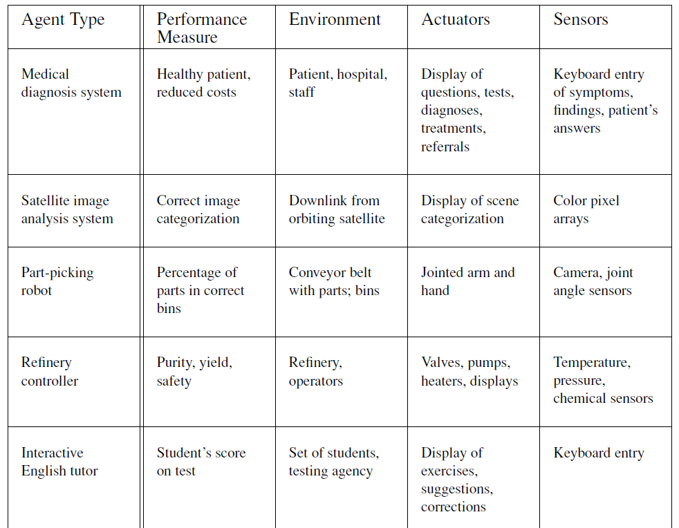

Slide 23
More on environments
Environment can be real, or artificial
Environment can be simple (ex: conveyor belt for inspection robot) or complex/rich (ex: flight simulator environment)
Key points are complexity of the relationships among the behavior of the robot, the percept sequence generated by the environment, and the performance measure

Slide 24
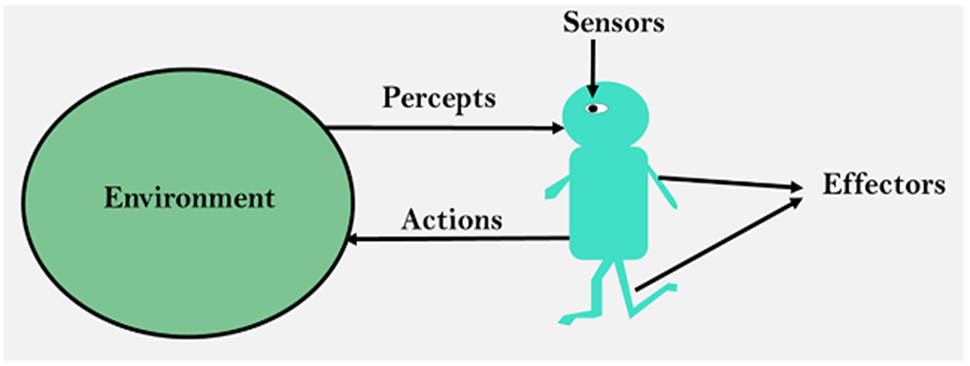
Agents in AI
Agents Introduction
In AI, an Agent is an autonomous software system that perceives its environment, reason about its environment, reasons about its goals, and takes actions to achieve those goals without human intervention.
An agent is anything that can be viewed as perceiving its environment through sensors and acting upon that environment through actuators.
Human agent - A human agent has
eyes, ears, and other organs for sensors;
hands, legs, mouth, and other body parts for actuators.
Robotic agent - A robotic agent can have
cameras and infrared range finders for sensors
various motors for actuators
Software Agent- Software agent can have
keystrokes, file contents as sensory input and
act on those inputs and display output on the screen.
39

Slide 25
Agents in AI
Agents Introduction
Sensor: Sensor is a device which detects the change in the environment and sends the information to other electronic devices. An agent observes its environment through sensors.
Actuators: Actuators are the component of machines that converts energy into motion. The actuators are only responsible for moving and controlling a system. An actuator can be an electric motor, gears, rails, etc.
Effectors: Effectors are the devices which affect the environment. Effectors can be legs, wheels, arms, fingers, wings, fins, and display screen.
Humans set goals, but an AI agent independently chooses the best actions it needs to perform to achieve those goals.
AI agents are software systems that use AI to pursue goals and complete tasks on behalf of users.
40

Slide 26
Term percept to refer to the agent’s perceptual inputs at any given instant
An agent’s percept sequence is the complete history of everything the agent has ever perceived
an agent’s choice of action at any given instant can depend on the entire percept sequence
observed to date, but not on anything it hasn’t perceived
an agent’s behavior is described by the agent function that maps any given percept sequence to
an action
[f: P* → A]
The agent program runs on the physical architecture to produce f, the agent function for an
artificial agent will be implemented by an agent program
agent = architecture + program
The agent function is an abstract mathematical description; the agent program is a concrete implementation, running within some physical system.

Slide 27
Structure of Agent
The job of AI is to design an agent program that implements the agent function the mapping from percepts to actions.
his program will run on some sort of computing device with physical sensors and actuators called the architecture
agent = architecture + program
architecture makes the percepts from the sensors available to the program, runs the program, and feeds the program’s action choices to the actuators as they are generated

Slide 28
Agent vs. Program
Size – an agent is usually smaller than a program.
Purpose – an agent has a specific purpose while programs are multi-functional.
Persistence – an agent's life span is not entirely dependent on a user launching and quitting it.
Autonomy – an agent doesn't need the user's input to function.

Slide 29
Agent Example
A file manager agent.
Sensors: commands like ls, du, pwd.
Actuators: commands like tar, gzip, cd, rm, cp, etc.
Purpose: compress and archive files that have not been used in a while.
Environment: fully observable (but partially observed), deterministic (strategic), episodic, dynamic, discrete.

Slide 30
Key Features of AI Agents
The following are the key features of AI Agents
Autonomous: Act without constant human input and decide next steps from past data like a bookstore bot flags missing invoices.
Goal‑driven: Optimize for defined objectives like a logistics AI balancing speed, cost and fuel use.
Perceptive: Gather info from sensors, inputs or APIs like a cybersecurity agent tracking new threats.
Adaptable: Adjust strategies when situations change.
Collaborative: Work with humans or other agents toward shared goals like healthcare agents coordinating with patients and doctor.
42

Slide 31
Good behaviour
Rationality: Agent selects action which maximizes the performance
Learn: Agent should learn from perceive sequences
Omniscient: Agent should know the outcome of its actions
Autonomous: Agent should compensate for half/inaccurate knowledge

Slide 32
Good Behaviour: Concept of Rationality
A rational agent is one that does the right thing
what does it mean to do the right thing?
by considering the consequences of the agent’s behavior
When an agent is plunked down in an environment, it generates a sequence of actions according to the percepts it receives. This sequence of actions causes the environment to go through a sequence of states. If the sequence is desirable, then the agent has performed well.
This notion of desirability is captured by a performance measure that evaluates any given sequence of environment states.

Slide 33
Rationality
What is rational at any given time depends on four things:
Performance measuring success
Agents prior knowledge of environment
Actions that agent can perform
Agent’s percept sequence to date
Rational Agent: For each possible percept sequence, a rational agent should select an action that is expected to maximize its performance measure, given the evidence provided by the percept sequence and whatever built-in knowledge the agent has.

Slide 34
Example- Vacuum Cleaner
The performance measure awards one point for each clean square at each time step
The “geography” of the environment is known a priori but the dirt distribution and the initial location of the agent are not. Clean squares stay clean and sucking cleans the current square. The Left and Right actions move the agent left and right except when this would take the agent outside the environment, in which case the agent remains where it is.
The only available actions are Left, Right, and Suck.
The agent correctly perceives its location and whether that location contains dirt

Slide 35
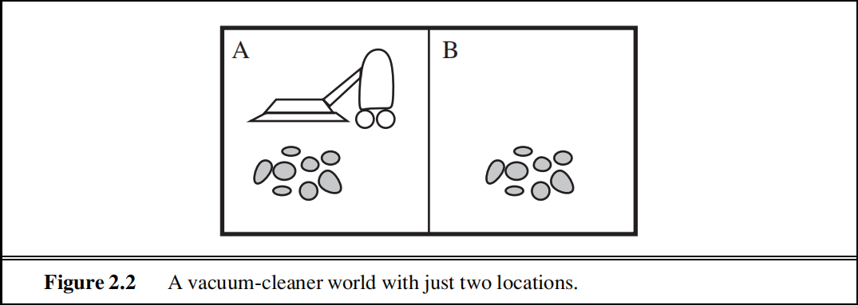
The Vacuum Cleaner World
This particular world has just two locations: squares A and B.
The vacuum agent perceives which square it is in and whether there is dirt in the square. It can choose to move left, move right, suck up the dirt, or do nothing.
One very simple agent function is the following: if the current square is dirty, then suck; otherwise, move to the other square.
Percepts: location and contents, e.g., [A,Dirty]
Actions: Left, Right, Suck, NoOp
Agent’s function → look-up table
For many agents this is a very large table

Slide 36
Omniscience, learning, and autonomy
Omniscient agent: knows the actual outcome of its actions and can act accordingly; but omniscience is impossible in reality.
Rationality is not the same as perfection.
Rationality maximizes expected performance, while perfection maximizes actual
performance
information gathering Exploration
learn as much as possible from what it perceives
rational agent should be autonomous—it should learn what it can to compensate for partial or incorrect prior knowledge

Slide 37
Agents in AI
What are the benefits of using AI agents?
AI agents can improve your business operations and your customers
experiences.
1. Improved productivity
Business teams are more productive when they delegate repetitive tasks to AI
agents. This way, they can divert their attention to mission-critical or creative
activities, adding more value to their organization.
2. Reduced costs
Businesses can utilize intelligent agents to minimize unnecessary costs
resulting from process inefficiencies, human errors, and manual processes.
3.Informed decision-making
Advanced intelligent agents have predictive capabilities and can collect and
process massive amounts of real-time data.
For example, you can use AI agents to analyze product demands in different
market segments when running an ad campaign.
41

Slide 38
AI Agents Architecture
AI Agent’s Architecture
An AI agent's architecture consists of two main components:
the software architecture (how the agent is structured) and
the agent program (the algorithms that drive decision-making).
AI agents differ from AI assistants and bots primarily in their level of autonomy and learning capabilities.
AI agents typically incorporate several functional modules that work together:
Profiling module: Collects and processes environmental data
Memory module: Stores experiences, facts, and rules
Planning module: Determines actions to achieve goals
Action module: Executes decisions in the environment
43

Slide 39
AI Agents Architecture
AI Agent’s Architecture
AI Agent Architectures examine the complex structures that shape how machines perceive, reason, and act in their environments in the pursuit of autonomous intelligence.
An intelligent agent system's basic components and interactions are outlined in an AI agent architecture, which functions as a conceptual design.
Agent architectures are important because they provide a methodical way to design and evaluate complex AI systems, enabling scientists and engineers to build agents with certain features and functions.
44

Slide 40
AI Agents Architecture
AI Agent’s Architecture
Let's discuss each component of AI Agent architecture in detail:
1. Profiling Module: The Eyes and Ears of the Agent
The agent is endowed with sensory expertise via the profiling module, it is also known as the perception module.
With the help of this module, the agent may collect and analyze information from its environment like how human senses work.
It interprets unprocessed sensory data, eliminates superfluous details, and extracts important characteristics that are essential for making decisions.
Example
Imagine a self-driving automobile car that has radar, lidar, and camera sensors. Through the processing of data from various sensors, the profile module recognizes barriers, traffic lights, and lane markers, allowing the vehicle to go safely.
45

Slide 41
AI Agents Architecture
2. Memory Module: The Repository of Knowledge
The memory module is essential for organizing and storing data as it serves as the agent's knowledge base. It allows the agent to remember information, rules, patterns, and events from the past. It functions similarly to the agent's short- and long-term memory.
For the agent to make wise judgments, learn from its interactions, and have a sophisticated grasp of its surroundings, this module is crucial.
Example
To provide timely and correct replies during discussions, a virtual assistant chatbot, uses its memory module to remember client requests, product specs, and commonly asked questions.
46

Slide 42
AI Agents Architecture
3. Planning Module: The Strategist Behind Decisions
The agent's central decision-making command post for making decisions and acting in a goal-oriented manner is the planning module.
This module examines the present situation and determines the best course of action to accomplish the agent's goals, taking into account information from the memory and profiling modules.
Example
A delivery routing agent utilizes the planning module to optimize the most effective routes and timetables for its fleet by taking into account variables like vehicle capacity, traffic patterns, and delivery priority.
47

Slide 43
AI Agents Architecture
4. Action Module: From Plans to Execution
The choices and plans established by the planning module are implemented by the action module. It converts plans into executable commands and serves as the agent's interface with the outside world. This module operates in conjunction with actuators or output devices, carrying out and overseeing the selected course of action.
Example
When a robotic arm is used in a factory, the action module gets instructions on how to pick up and move things. It then sends signals to the robot's motors to carry out the exact motions required to ensure precision assembly jobs.
48

Slide 44
AI Agents Architecture
5. Learning Strategies: The Engine of Adaptation
The incorporation of learning strategies—mechanisms that let agents change, become better, and learn new things—is essential to agent architecture. Common methods include supervised learning,
unsupervised learning, and reinforcement learning. Reinforcement learning directs agents' behavior toward the best results by providing feedback in the form of incentives or punishments.
Example
By improving the agent's capacity to draw conclusions from the past and adjust to new circumstances, these learning techniques help them improve their performance over time.
49

Slide 45
Types of AI Agents
AI agents operate and solve problems in specific ways. Different types of agents are suited to different tasks, and they can work in tandem to accomplish larger projects.
Simple reflex agents
Model-based reflex agents
Goal-based agents
Utility-based agents
Learning agents
Multi-agent systems (MAS)
Hierarchical Systems
50

Slide 46
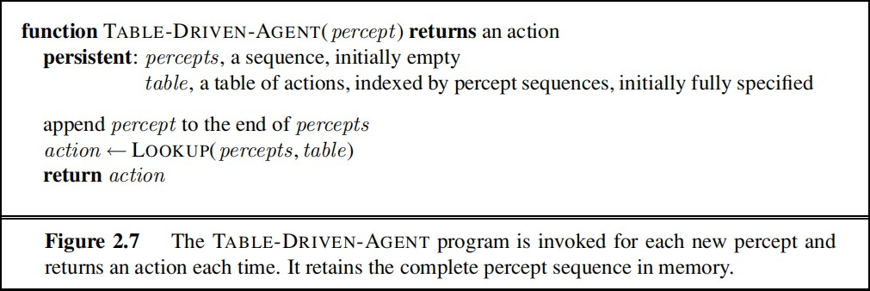
Agent programs
Agent program: use current percept as input from the sensors and return an action to the actuators
Agent function: takes the entire percept history
To build a rational agent in this way, we as designers must construct a table that contains the appropriate action for every possible percept sequence.

Slide 47
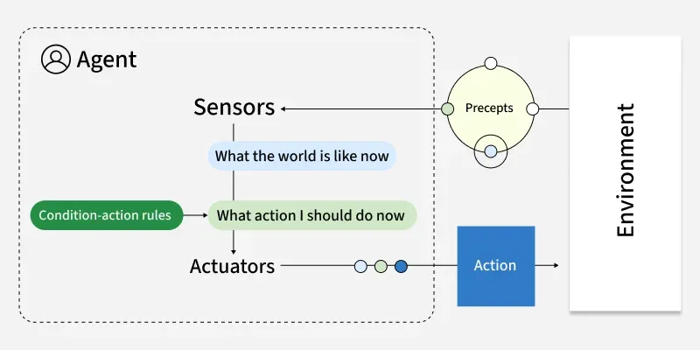
Types of AI Agents
Simple reflex agents
Simple reflex agents act solely on the current percept using predefined condition–action rules, without storing or considering any history.
They are fast and easy to implement, making them suitable for fully observable, stable environments with clear and simple rules. However, they tend to fail in dynamic or partially observable situations because they lack memory and deeper reasoning capabilities.
Example: Traffic light control systems that change signals based on fixed timing.
51

Slide 48
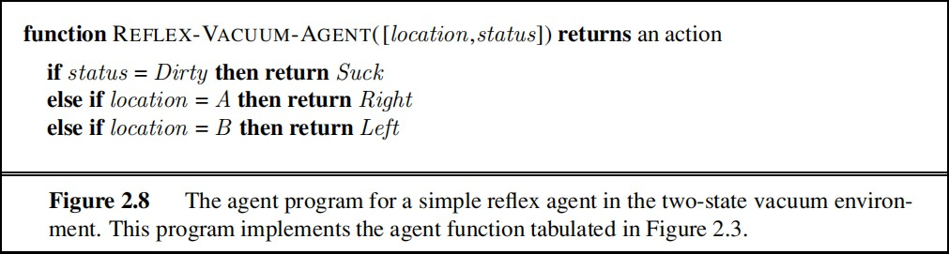
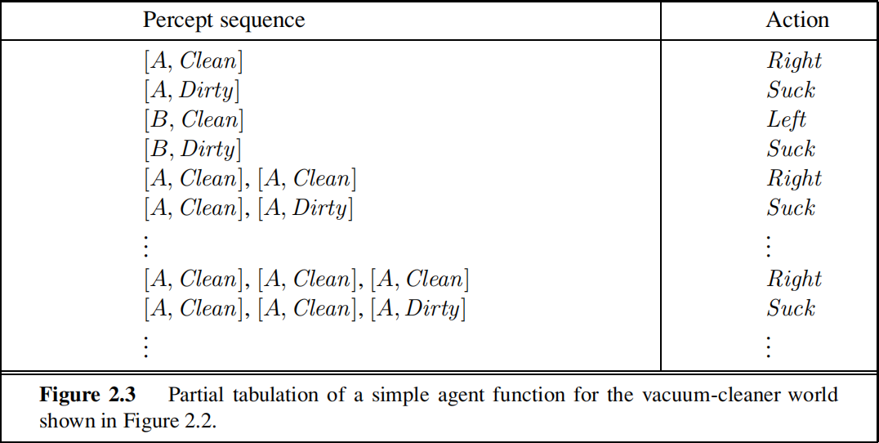
Simple reflex agents
Select actions on the basis of the current percept, ignoring the rest of the percept history
Agents do not have memory of past world states or percepts.
So, actions depend solely on current percept.
Action becomes a “reflex.”
Uses condition-action rules.

Slide 49
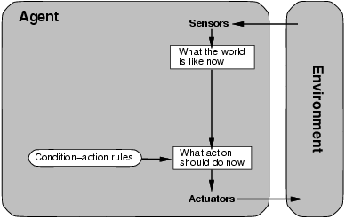
If tail-light of car in front is red, then brake.
condition–action rule
if car-in-front-is-braking then initiate-braking

Slide 50
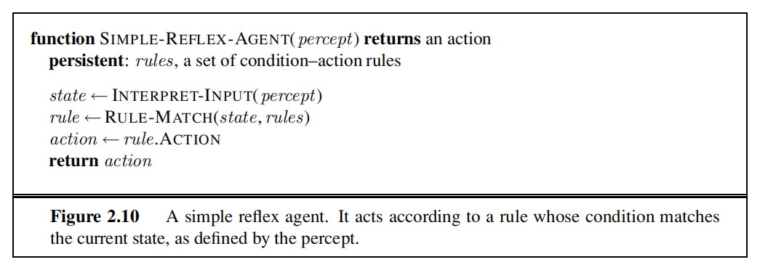
The INTERPRET-INPUT function generates an abstracted description of the current state from the percept, and
the RULE-MATCH function returns the fifirst rule in the set of rules that matches
the given state description. Note that the description in terms of “rules” and “matching” is purely conceptual;
actual implementations can be as simple as a collection of logic gates
implementing a Boolean circuit

Slide 51
This will work only if the correct decision can be made on the basis of only the current percept—that is, only if the environment is fully observable.
Even a little bit of unobservability can cause serious trouble. For example, the braking rule given earlier assumes that the condition car-in-front-is-braking can be determined from the current percept—a single frame of video.
This works if the car in front has a centrally mounted brake light.
Infinite loops are often unavoidable for simple reflex agents operating in partially observable environments
Escape from infifinite loops is possible if the agent can randomize its actions.

Slide 52
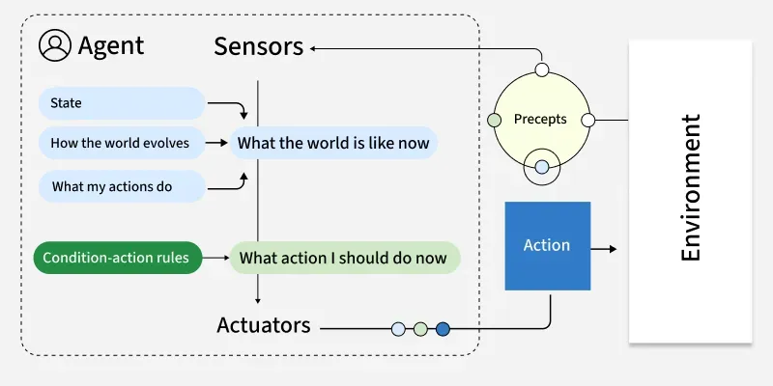
Types of AI Agents
2.Model-Based Reflex Agents
Model-Based Reflex Agents enhance the simple reflex approach by maintaining an internal state or model of the world, that tracks aspects of the environment not directly observable at each moment. This enables them to deal with partial observability and dynamic changes more effectively, although their decisions are still largely reactive and dependent on the accuracy of the model they maintain.
Example: Robot vacuum cleaners that map rooms and tracks cleaned areas.
52

Slide 53
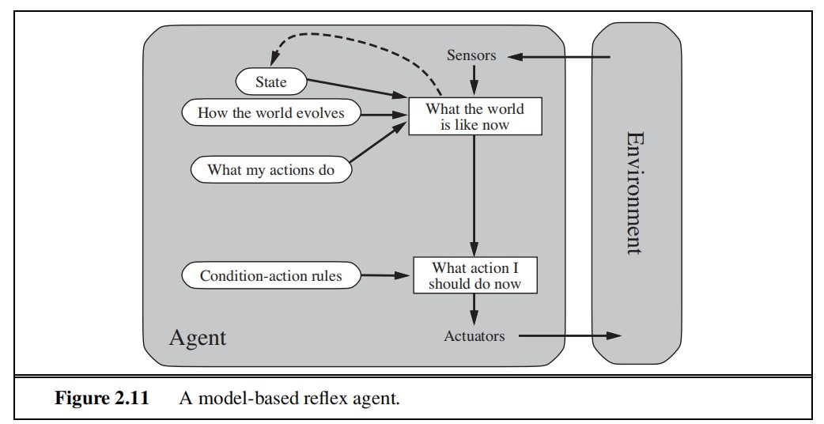
represents the
agent’s “best guess”
“Infers potentially dangerous driver in front.”
If “dangerous driver in front,”
then “keep distance.”

Slide 54
Model-based reflex agents
Key difference (wrt simple reflex agents):
Agents have internal state, which is used to keep track of past states of the world.
Agents have the ability to represent change in the World.
internal state information as time goes by requires two kinds of knowledge to be encoded in the agent program
we need some information about how the world evolves independently of the agent
we need some information about how the agent’s own actions affect the world
knowledge about “how the world works is called a model of the world. An agent that uses such a model is called a model-based agent.

Slide 55
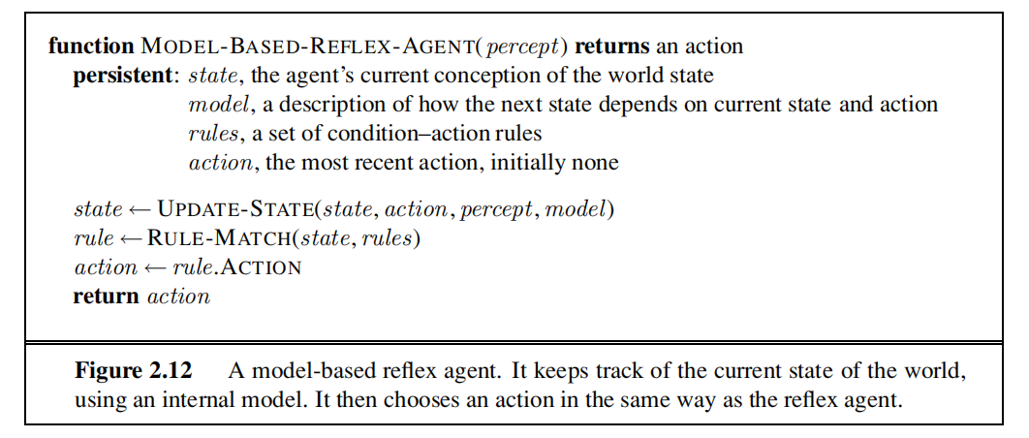
UPDATE-STATE, which is responsible for creating the new internal state description.

Slide 56
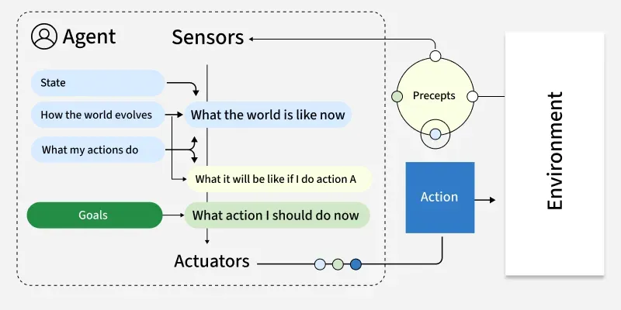
Types of AI Agents
3. Goal-Based Agents
Goal Based Agents select actions by considering future states relative to explicit goals. They are capable of planning sequences of actions to reach these goals rather than just reacting to the current state which enables more flexible and intelligent problem-solving.
Example: Logistics routing agents that find optimal delivery routes based on factors like distance and time.
53

Slide 57
Goal-based agents
Key difference wrt Model-Based Agents:
In addition to state information, have goal information that
describes desirable situations to be achieved.
Search and planning are the subfields of AI devoted to finding action sequences that achieve the
agent’s goals
Agents of this kind take future events into consideration.
What sequence of actions can I take to achieve certain goals?
Choose actions so as to (eventually) achieve a (given or computed) goal.

Slide 58
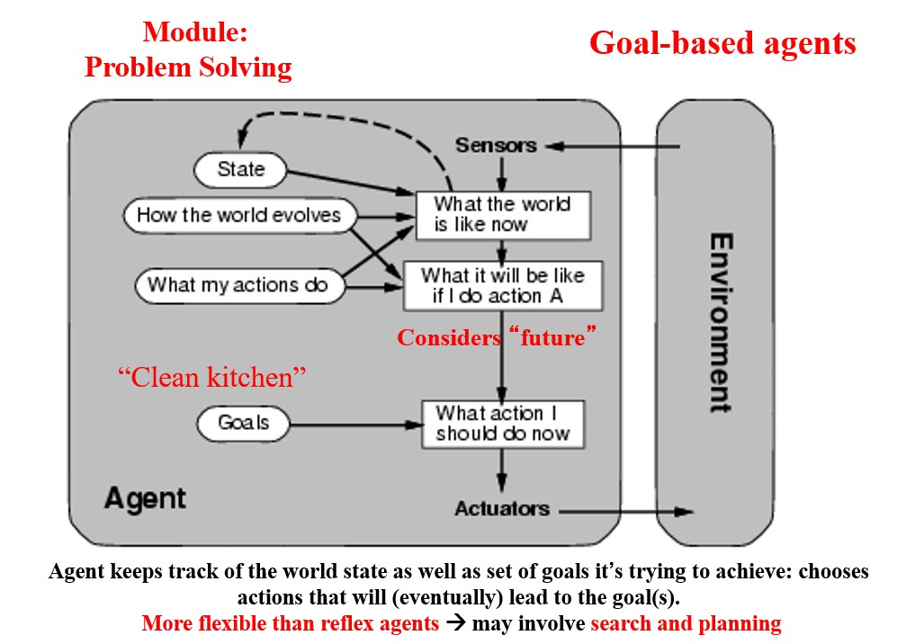

Slide 59
Types of Agents in AI
4. Utility-Based Agents
Utility Based Agents extends goal-based reasoning by considering not only whether a goal is met but also how valuable or desirable a particular outcome is.
They use a utility function to quantify preferences and make trade-offs between competing objectives, enabling nuanced decision-making in uncertain or resource-limited situations.
Example:
Financial portfolio management agents that evaluate investments based on factors like risk, return and diversification operate by choosing options that provide the most value.
54

Slide 60
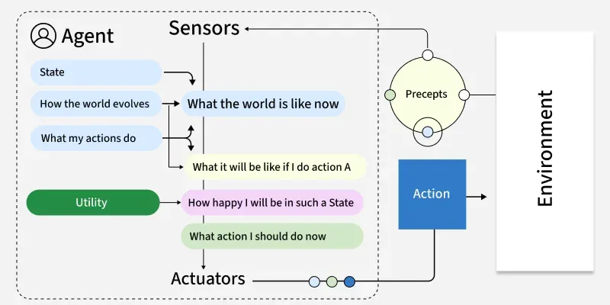
Types of Agents in AI
4. Utility-Based Agents
55

Slide 61
Utility-based agents
Goals alone are not enough to generate high-quality behavior in most environments
Goals just provide a crude binary distinction between “happy” and “unhappy”
states
Because “happy” does not sound very scientific, economists and computer
scientists use the term utility instead
An agent’s utility function is essentially an internalization of the performance measure. If the internal utility function and the external performance measure are in agreement, then an agent that chooses actions to maximize its utility will be rational according to the external performance measure.

Slide 62
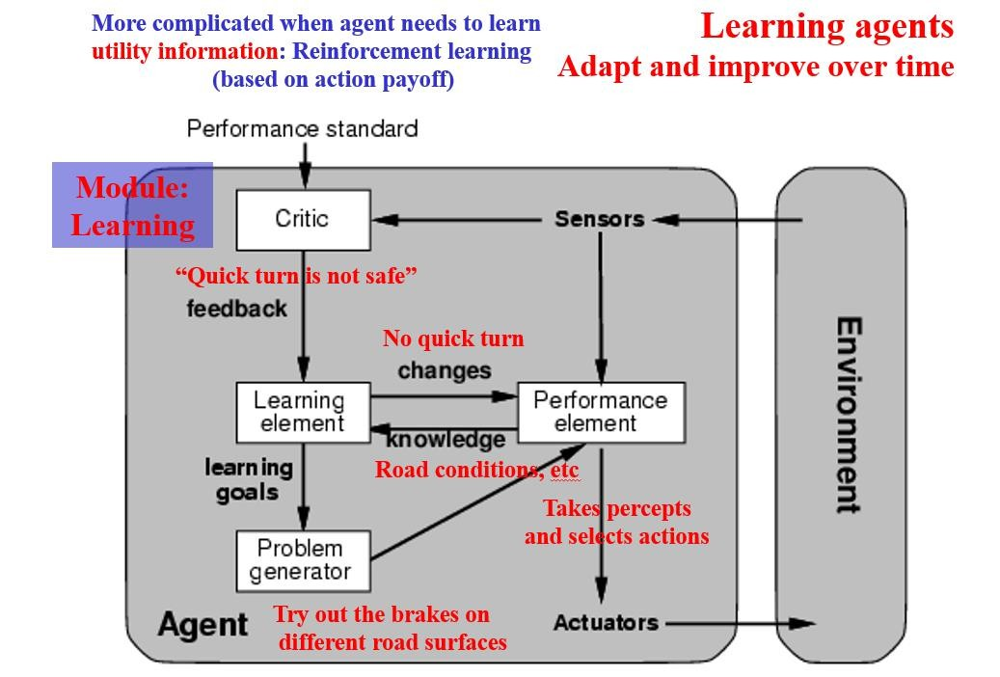

Slide 63
Types of Agents in AI
5. Learning Agents
Learning Agents improve their performance over time by learning from experience and updating their internal models, strategies or policies.
They can adapt to changes in the environment and often outperform static agents in dynamic contexts.
Learning may involve supervised, unsupervised or reinforcement learning techniques and these agents typically contain both a performance element (for acting) and a learning element (for improving future actions).
Example: Customer service chatbots can improve response accuracy over time by learning from previous interactions and adapting to user needs.
56

Slide 64
Learning Agents
Agents capable of acquiring new competence through observations and actions.
Components:
learning element (modifies the performance element)
performance element (selects actions)
feedback element (critic)
exploration element (problem generator).

Slide 65
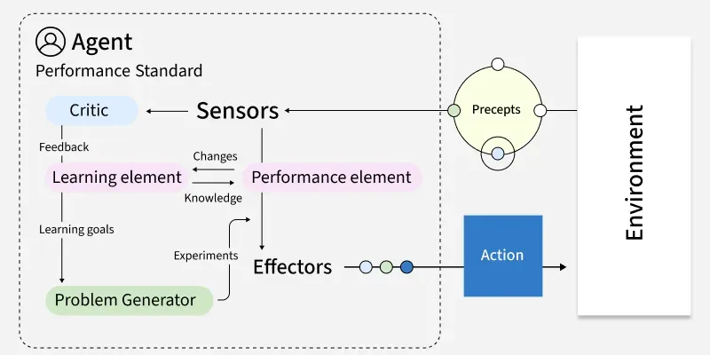
Types of Agents in AI
5. Learning Agents
57

Slide 66
A learning agent can be divided into four conceptual components
learning element, which is responsible for making improvements
performance element, which is responsible for selecting external actions. The performance element is what we have previously considered to be the entire agent: it takes in percepts and decides on actions.
Feedback from the critic : on how the agent is doing and determines how the performance
element should be modified to do better in the future
problem generator. It is responsible for suggesting actions that will lead to new and informative experiences

Slide 67
Intelligent Agent
Agent: entity in a program or environment capable of generating action.
An agent uses perception of the environment to make decisions about actions to take.
The perception capability is usually called a sensor.
The actions can depend on the most recent perception or on the entire history (percept sequence).

Slide 68
Environment
Environment
Sensors
Percept (Observations)
Agent Function
Agent
Actuator
Action
Environment
Environment

Slide 69
Rational Agent
A rational agent is one that can take the right decision in every situation.
Performance measure: a set of criteria/test bed for the success of the agent's behavior.
The performance measures should be based on the desired effect of the agent on the environment.

Slide 70
Rationality
The agent's rational behavior depends on:
the performance measure that defines success
the agent's knowledge of the environment
the action that it is capable of performing
the current sequence of perceptions.
Definition: for every possible percept sequence, the agent is expected to take an action that will maximize its performance measure.

Slide 71
Agent Autonomy
An agent is omniscient if it knows the actual outcome of its actions. Not possible in practice.
An environment can sometimes be completely known in advance.
Exploration: sometimes an agent must perform an action to gather information (to increase perception).
Autonomy: the capacity to compensate for partial or incorrect prior knowledge (usually by learning).

Slide 72
Environment
Task environment – the problem that the agent is a solution to.
Properties:
Observable - fully or partially A fully observable environment needs less representation.
Deterministic or stochastic Strategic –deterministic except for the actions of other agents.

Slide 73
Types of Agents in AI
6. Multi-Agent Systems (MAS)
Multi-Agent Systems operate in environments shared with other agents, either cooperating or competing to achieve individual or group goals. These systems are decentralized, often requiring communication, negotiation or coordination protocols.
They are well-suited to distributed problem solving but can be complex to design due to emergent and unpredictable behaviors.
Example:
A warehouse robot might use:
Model-based reflexes for navigation
Goal-based planning for task sequencing
Utility-based decision-making for prioritizing tasks
Learning capabilities for route optimization
58

Slide 74
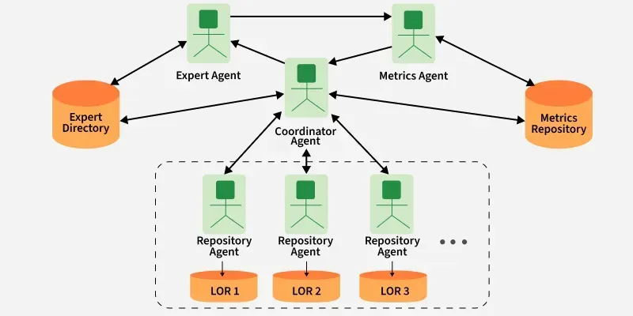
Types of Agents in AI
6. Multi-Agent Systems
59

Slide 75
Types of Agents in AI
7. Hierarchical Systems
Hierarchical agents/systems organize the behavior into multiple layers such as strategic, tactical and operational.
Higher levels make abstract decisions that break down into more specific subgoals for lower levels to execute.
This structure improves scalability, reusability of skills and management of complex tasks, but requires designing effective interfaces between layers.
Example:
Drone delivery systems in which fleet management is done at top level and individual navigation at lower level.
60

Slide 76
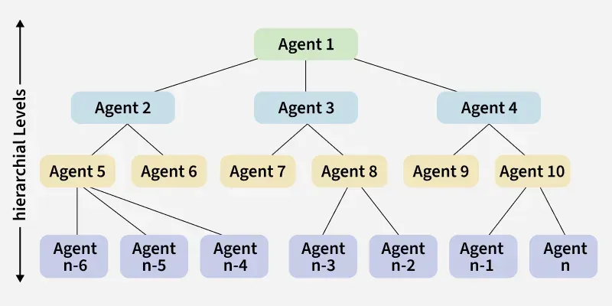
Types of Agents in AI
7. Hierarchical Systems
61

Slide 77
Other Types of Agents
Temporarily continuous – a continuously running process,
Communicative agent – exchanging information with other agents to complete its task.
Mobile agent – capable of moving from one machine to another one (or from one environment to another).
Flexible agent – whose actions are not scripted.
Character – an agent with conversation skills, personality, and even emotional state.

Slide 78
When to Use Each AI Agent Type
1. Simple Reflex Agent
Environment is fully observable and predictable
Tasks are repetitive with fixed rules
2. Model-Based Reflex Agent
Some information about the environment is hidden but can be modeled
Environment changes but follows predictable patterns
3. Goal-Based Agent
Tasks require planning multiple steps ahead
Clear goals are defined and can be measured
4. Utility-Based Agent
Need to balance trade-offs like cost, time and risk
Multiple objectives must be prioritized
62

Slide 79
When to Use Each AI Agent Type
5. Learning Agent
Environment changes over time and the system must adapt
Performance should improve with experience
6. Multi-Agent System (MAS)
Multiple agents must work together or compete
Problem-solving is decentralized and distributed
7. Hierarchical Agent
Tasks can be split into strategic, tactical and operational levels
Large-scale operations require coordination between layers
63

Slide 80
Knowledge-Based Agents in AI
Introduction
Knowledge-based agents in AI are intelligent systems that use a knowledge base to make decisions and solve problems.
Knowledge-based agents are those agents who have the capability of maintaining an internal state of knowledge, reason over that knowledge, update their knowledge after observations and take actions.
Knowledge-based agents are composed of two main parts:
1. Knowledge-base and
2. Inference system
64

Slide 81
Knowledge-Based Agents in AI
Knowledge-Based Agents(contd.,)
A knowledge-based agent must able to do the following:
• An agent should be able to
represent states, actions, etc.
incorporate new perceptions
• An agent can update the internal representation of the world
• An agent can deduce
the internal representation of the world
appropriate actions.
65

Slide 82
Knowledge-Based Agents in AI
Knowledge-Based Agents Architecture
The architecture of knowledge-based agent states with :
The knowledge-based agent (KBA) take input from the environment by perceiving the environment.
The input is taken by the inference engine of the agent and which
also communicate with knowledge-based (KB) to decide as per the
knowledge store in KB.
The learning element of knowledge-based agent (KBA) regularly updates the knowledge-based (KB) by learning new knowledge.
66

Slide 83
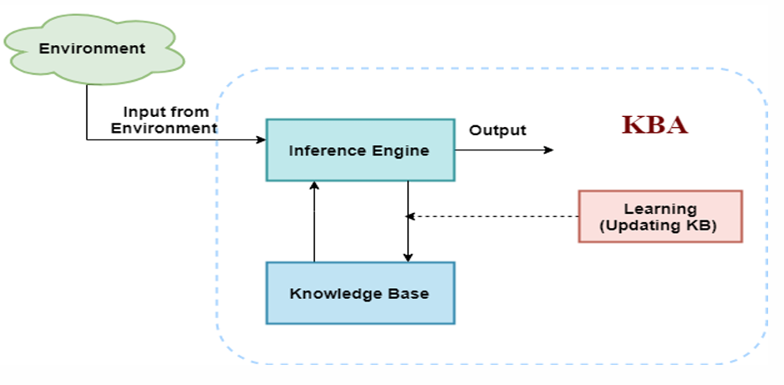
Knowledge-Based Agents in AI
Knowledge-Based Agents Architecture
67

Slide 84
Knowledge-Based Agents in AI
Operations performed by Knowledge-Based Agents
Following are three operations which are performed by KBA in order to show the intelligent behavior:
1. Tell: This operation tells the knowledge base, what it discuss from the
environment.
2. Ask: This operation asks the knowledge base what action it should perform.
3. Perform: It performs the selected action.
68

Slide 85
Environment in AI
Introduction
Environment can be real, or artificial
Environment can be simple (ex: conveyor belt for inspection robot) or complex/rich (ex: flight simulator environment)
Key points are complexity of the relationships among the behavior of the robot, the percept sequence generated by the environment, and the performance measure
69

Slide 86
Properties of Task Environments in AI
1.Fully observable vs partially observable
Fully: agent’s sensors give access to the complete state of environment at each point in time
Effectively fully if sensors detect all aspects relevant to choice of action (as determined by performance measure)
Fully: agent doesn’t need internal state to keep track of the world
2. Deterministic vs stochastic
Deterministic if next state of environment is completely determined by current state and action executed by agent
Partially observable environment could appear to be stochastic
Strategic environment: deterministic except for actions of other agents
70

Slide 87
Properties of Task Environments in AI
3. Episodic vs sequential
Episodic environment: agent’s experience is divided into ‘atomic episode’; each episode consists of agent perceiving then performing a single action
Episodes are independent: next episode doesn’t depend on actions taken in previous episodes
Ex: classification tasks: spotting defective parts on an assembly line
Sequential: current decision could affect all future decisions (ex: chess playing)
71

Slide 88
Properties of Task Environments in AI
5. Static vs dynamic
Dynamic:
environment can change while agent is deliberating
Semi dynamic:
performance score can change with passage of time, but environment doesn’t (ex: playing chess with a clock)
6.Discrete vs Continuous
Distinction can be applied to state of the environment, way time is handled, percepts and actions of the agent
72

Slide 89
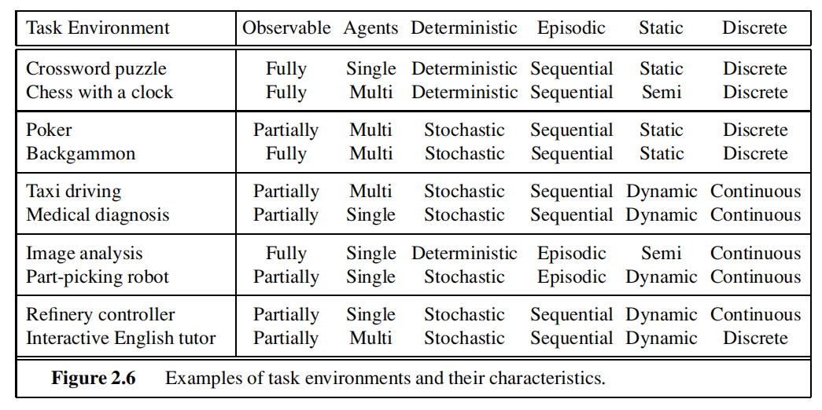

Slide 90
Environment summary in AI
Solitaire: observable, deterministic, sequential, static, discrete, single-agent
Backgammon: observable, deterministic, sequential, semi-static, discrete, multi-agent
Internet shopping: partially observable, partially deterministic, sequential, semi-static, discrete, single-agent (except auctions)
Taxi driving (“the real world”): partially observable, not deterministic, sequential, dynamic, continuous, multi-agent
73

Slide 91
Wumpus World Problem
Introduction
The Wumpus World is inspired by the video game “Hunt the Wumpus” by Gregory Yob in 1973.
Wumpus World is an classical example of the knowledge-based agent that represents knowledge representation, planning, and reasoning to achieve the goal.
Wumpus World is a classic example used in educational contexts to teach fundamental concepts in AI, such as logical reasoning and decision-making.
In the Wumpus World, an agent is trying to find gold in the Wumpus cave.
In this world, there are some Pits rooms that are bottomless, and if the agent enters the Pits, he will be stuck there forever.
The agent's main goal is to find the gold and leave the cave without entering Wumpus and Pit's room.
74

Slide 92
Wumpus World Problem
Introduction
It involves reasoning, knowledge representation and planning. In this agent uses its knowledge of the world to make decisions and navigate safely in the given environment.
Understanding Wumpus World Problem
Wumpus World is a 4x4 grid consisting of 16 rooms. Agent starts at Room[1,1] facing right and its goal is to retrieve treasure while avoiding hazards such as pits and the Wumpus. Agent must navigate through grid using its limited sensory input to make decisions that will keep it safe and allow it to successfully collect the treasure and exit the cave.
The agent will be rewarded if he comes out with gold. Otherwise, he will be penalized if he falls into the Pit or is eaten by the Wumpus.
75

Slide 93
Wumpus World Problem
The agent must use logical reasoning to interpret these clues and safely navigate
the environment.
The use of logic in deducing the correct actions based on perceptual inputs
makes Wumpus World a classic problem for studying AI.
Static vs. Dynamic Wumpus
Static Wumpus: The Wumpus remains in a fixed location, making it easier to avoid.
Dynamic Wumpus: The Wumpus moves unpredictably, increasing complexity.
In basic AI simulations, Wumpus World is typically static, allowing agents to focus on logical inference and strategic exploration. It provides a foundational framework for developing AI models that reason under uncertainty and make optimal decisions based on limited perception.
76

Slide 94
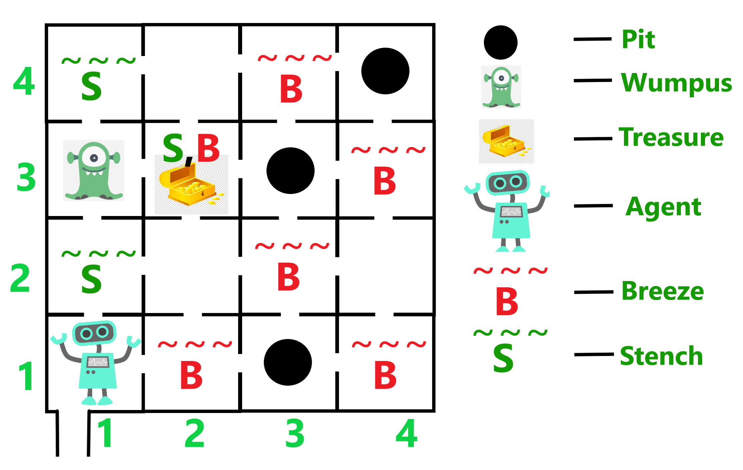
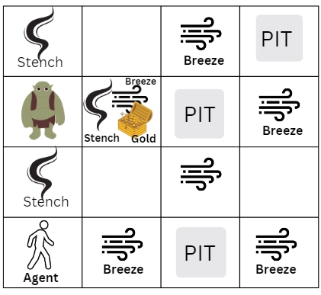
Wumpus World Problem - Example
Problem States/ Example
77

Slide 95
Wumpus World Problem
The Wumpus World is a grid-based environment where the agent must navigate to achieve a goal while avoiding obstacles.
The world contains:
Pits: Falling into a pit leads to failure.
Wumpus: It is a beast that creature that the agent must avoid or eliminate.
Gold: The agent’s objective is to find the gold.
Walls: Boundaries that limit movement within the grid.
The agent can perceive:
Breeze: Indicates that there is a pit in an adjacent square.
Stench: Indicates that the Wumpus is in an adjacent square.
Glitter: Indicates that the gold is in the current square.
78

Slide 96
Wumpus World Problem
Key Elements
Pits: If the agent steps into a pit it falls and dies. A breeze in adjacent rooms suggests nearby pits.
Wumpus: A creature that kills agent if it enters its room. Rooms next to the Wumpus have a stench. Agent can use an arrow to kill the Wumpus.
Treasure: Agent’s main objective is to collect the treasure (gold) which is located in one room.
Breeze: Indicates a pit is nearby.
Stench: Indicates the Wumpus is nearby.
Agent must navigate carefully avoiding dangers to collect treasure and exit safely.
79

Slide 97
Wumpus World Problem
Properties of the Wumpus World
The properties of the Wumpus World problem are
Partially Observable: The agent can only recognize its adjacent rooms that’s why the Wumpus World is partially observable.
Deterministic: The result is already known, so it is deterministic.
Sequential: The order followed by the agent is important, so it is sequential.
Static: Only the agent is moving. Wumpus and Pits stay at the same place.
Discrete: The environment in the Wumpus World is discrete. This means that the map has a finite number of actions, rooms, and outcomes.
Single agent: Only a single knowledge-based agent is in the Wumpus World.
80

Slide 98
Wumpus World Problem
PEAS Description
To build an intelligent agent for the Wumpus World, we must first define the problem's Performance Measures, Environment, Actuators, and Sensors (PEAS).
P: Performance measure
E: Environment
A: Actuators / Actions
S: Sensors
1.Performance Measures: (Rewards or Punishments)
The following rules will measure the agent's performance.
Agent gets gold and return back safe = +1000 points
Agent dies (pit or Wumpus)= -1000 points
Each move of the agent = -1 point
Agent uses the arrow = -10 points
The game is over if either agent dies or exits the tunnel.
81

Slide 99
Wumpus World Problem
2. Environment: A setting where everything will take place.
The environment of the agent is described below:
A cave with 16(4x4 grid) rooms.
Agent's initial position/location - Room[1, 1] and facing right side.
Rooms adjacent (not diagonally) to the Wumpus are stenches.
Rooms adjacent (not diagonally) to the pit are breezy.
Room with gold glitters.
Location of Wumpus, gold and 3 pits can be anywhere except in Room[1, 1].
82

Slide 100
Wumpus World Problem
3. Actuators/Actions:
Actuators/Actions that the agent can perform the actions/activities are known as Actuators. The actions of the agents are as follows:
Move forward: Move to next room.
Turn right/left: Rotate agent 90 degrees.
Shoot: Kill Wumpus with arrow.
Grab: Take treasure.
Release: Drop treasure
83

Slide 101
Wumpus World Problem
4. Sensors:
Devices help the agent in sensing following from the environment.
Breeze: Detected near a pit.
Stench: Detected near the Wumpus.
Glitter: Detected when treasure is in the room.
Scream: Triggered when Wumpus is killed.
Bump: Occurs when hitting a wall.
This process repeats till the agent finds the cave using its sensory inputs, reasoning and planning to achieve its goal safely.
By using PEAS framework agent’s interactions with its environment are clearly defined, providing a structured approach to modeling intelligent behavior.
84

Slide 102
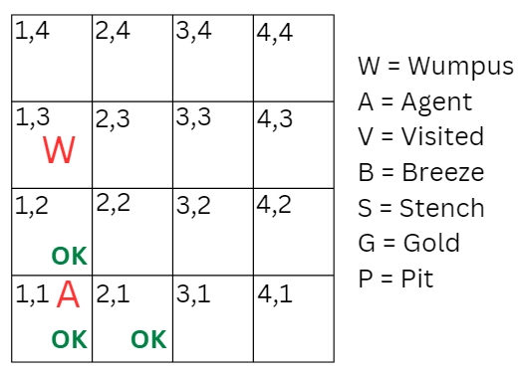
Wumpus World Problem
Step-1
Initially, the agent is in the room [1,1] and does not feel any Breeze or any Stench which means the adjacent rooms are also OK. Room [1,1] is safe, so we will add a symbol OK.
85

Slide 103
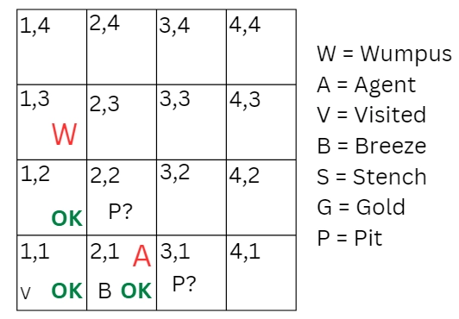
Wumpus World Problem
Step-2
Now agent has only two options, either he can move to [1,2] or [2,1]. Suppose the agent chooses to move to the room [2,1]. In this room, the agent recognizes the breeze, which means Pit is around this room. The Pit can be in [3,1] or [2,2], so he will add a recognition symbol P to say that this is a Pit room.
Now agent will stop and go back to the room [1,1]. The room [1,1] and [2,1] are now visited by the agent, so we will use the symbol V to represent the visited rooms.
86

Slide 104
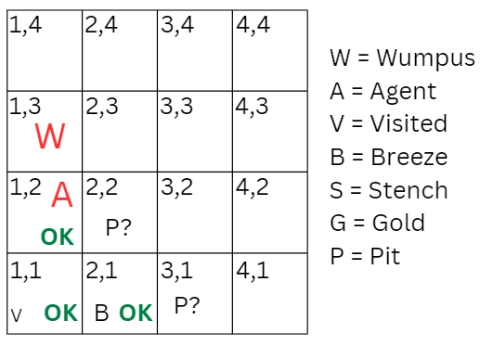
Wumpus World Problem
Step-3
Now the agent will move to [1,2] room which is OK. In this room, the agent perceives a stench that denotes a Wumpus around the room. But Wumpus cannot be in the room [1,1] as it is already visited and also not in [2,2] because when the agent was at [2,1], he had not detected any stench.
Therefore agent guesses that Wumpus is in the room [1,3], and in the current room, there is no breeze which means there is no Pit in the room [2,2]. So finally, the agent marks OK and moves further into the room [2,2].
87

Slide 105
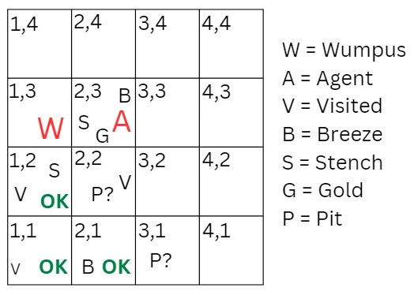
Wumpus World Problem
Step-4
Now, the agent is in the room [2,2], and there is no breeze and stench present, so let’s suppose the agent decides to move into the room [2,3]. In this room [2,3] agent perceives glitter, so he will grab the gold and climb out of the cave.
Note: The problem is successfully solved if Agent ‘A’ is safe at the end without being eaten up by the Wumpus ‘W’ or avoiding falling into the pit ‘P’.
88

Slide 106
Applications of Wumpus World Problem in AI
The Wumpus World in AI is a classic problem with multiple uses, including:
Developing intelligent agents: The Wumpus World in AI is an excellent platform for creating intelligent agents capable of navigating complicated environments, reasoning in uncertainty, and planning actions.
Testing AI algorithms: Wumpus World is a benchmark issue for testing and comparing various AI algorithms, such as search, planning, and reinforcement learning.
Education and training: Because it is simple to use and offers hands-on experience, the Wumpus World in AI is a popular tool for teaching AI concepts and algorithms to students.
Game Development: Wumpus World can motivate developers to create challenging and engaging games requiring strategic thinking and problem-solving.
Robotics: The Wumpus World can be used as a testing and development setting for robotics algorithms such as pathfinding and mapping.
89

Slide 107
Examples of PEAS in AI Applications
1) Autonomous Vehicle
Performance Measure: Safety, fuel efficiency, adherence to traffic laws, and timely arrival.
Environment: Roads, other vehicles, pedestrians, and weather conditions.
Actuators: Steering wheel, brakes, accelerator, and turn signals.
Sensors: Cameras, Lidar, radar, GPS, and ultrasonic sensors.
2) Virtual Assistant
Performance Measure: Task completion, accuracy, and user satisfaction.
Environment: Digital interfaces, apps, user commands, and connected devices.
Actuators: Voice output and device control.
Sensors: Microphones and speech recognition technology.
90

Slide 108
Examples of PEAS in AI Applications
3) Part-Picking Robot (in a factory):
Performance Measure: Precision, speed, and quality of production, measured by the percentage of parts in the correct bins.
Environment: A manufacturing floor with machinery and a conveyor belt for parts.
Actuators: Robotic arms and conveyor belt motors.
Sensors: Cameras, proximity sensors, and force sensors to identify and manipulate parts.
4) Hospital Management System
Performance Measure: Patient's health, Admission process, Payment
Environment: Hospital, Doctors, Patients
Actuators: Prescription, Diagnosis, Scan report
Sensors: Symptoms, Patient's response
91

Slide 109
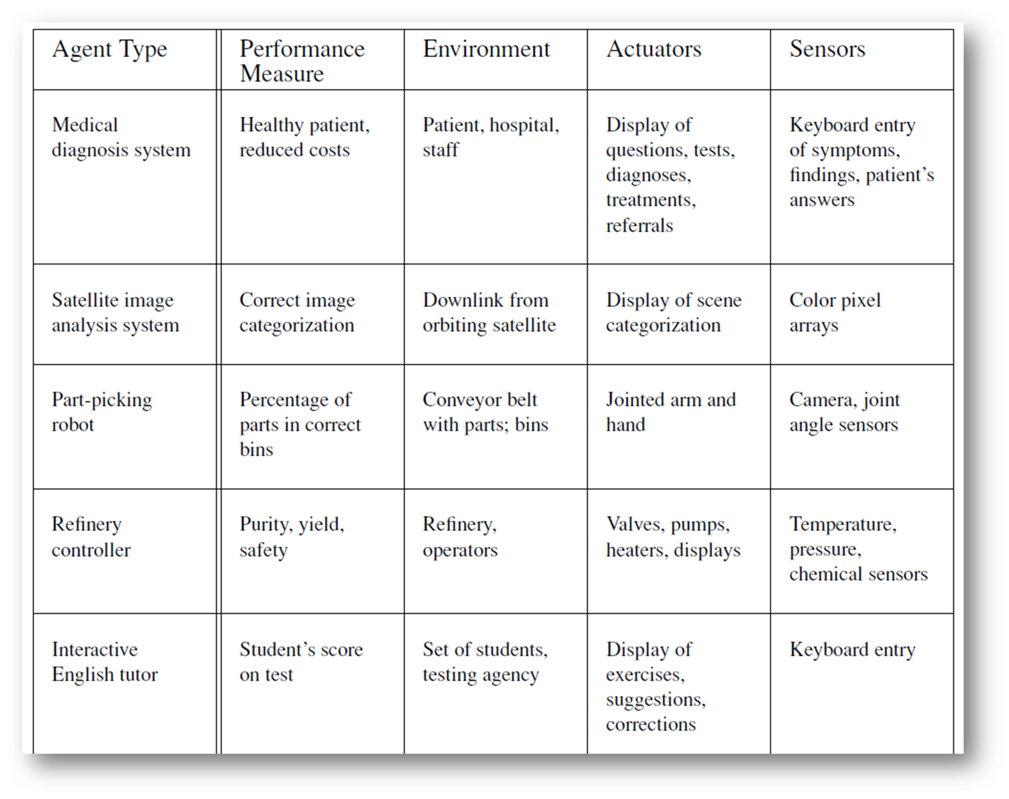
Examples of PEAS in AI Applications
92

Slide 110
Intelligent Agents in AI
An intelligent agent is an autonomous entity which act upon an environment using sensors and actuators for achieving goals.
An intelligent agent may learn from the environment to achieve their goals. A thermostat is an example of an intelligent agent.
Following are the main four rules for an AI agent:
Rule 1: An AI agent must have the ability to perceive the environment.
Rule 2: The observation must be used to make decisions.
Rule 3: Decision should result in an action.
Rule 4: The action taken by an AI agent must be a rational action.
93

Slide 111
Agent Communication in AI
AI agent communication refers to how artificial intelligence agents interact with each other, humans or external systems to exchange information, make decisions and complete tasks.
This communication is especially important in multi-agent systems, where multiple AI agents collaborate, and in human-AI interaction.
This is achieved through Agent Communication Languages (ACLs), which define message formats and syntax, and Agent Communication Protocols (ACPs) that establish the rules for dialogue and interaction.
These protocols are essential for enabling interoperability, scalability, and efficient task distribution in multi-agent systems.
94

Slide 112
Agent Communication in AI
How AI Agent Communication will Works
1. Message Content
Agents send messages to each other, expressing their intentions, requests, or information.
2. Structured Communication
Agent Communication Languages (ACLs) provide the grammar and structure for these messages, ensuring that agents can understand the meaning and context of the communication.
3. Interaction Protocols
Agent Communication Protocols (ACPs) define the rules for dialogue, including the order of messages, how to negotiate, and how to resolve conflicts.
4. Interoperability
By using common ACPs, different agents, developed with varying architectures or technologies, can still communicate effectively.
95

Slide 113
Agent Communication in AI
Communication Models
Among Agents the communication can be done in 2 ways.
Direct Communication
Indirect Communication
1.Direct Communication
In this communication Agents can send and receive messages directly.
Examples include :
Peer-to-Peer Messaging: Agents communicate directly with each other using defined protocols.
Client- Server Model: One agent (server) provides services or information to other agents (clients).
2.Indirect Communication
Agents can communicate via a shared medium or repository.
Examples include : Blockboard Systems, Shared Memory.
96

Slide 114
Agent Communication in AI
Key Components
1.Agent Communication Languages (ACLs)
Examples include KQML (Knowledge Query and Manipulation Language) and FIPA-ACL (Foundation for Intelligent Physical Agents Agent Communication Language), which specify performatives (message types like "request," "inform," "negotiate").
2.Agent Communication Protocols (ACPs)
Frameworks like the IBM ACP (Agent Communication Protocol) simplify agent-to-agent communication by using standard HTTP requests, making it accessible via common tools. ACPs aim to provide a comprehensive framework for agent discovery, configuration, execution, and interaction.
97

Slide 115
Agent Communication in AI
Types of AI Agent communication
AI agents communicate in various ways depending on their role, environment and goals.
Communication can be explicit or implicit, involving direct message exchanges or indirect observation of actions.
1.Agent-to-agent communication
Most agents are powered by LLMs, so they often talk to one another in natural human language. Agents must be able to not only share information, but express intention, coordinate within a hierarchy and negotiate over resource allocation.
Many AI agents rely on cloud computing and Internet of Things (IoT) devices to exchange real-time data.
Cloud AI systems store, retrieve and analyze large-scale datasets, while IoT-connected devices share sensor information across networks.
98

Slide 116
Agent Communication in AI
Types of AI Agent communication
2.Human-AI communication
AI agents also communicate with humans using natural language processing (NLP), speech recognition and visual interfaces.
Virtual assistants like OpenAI’s ChatGPT, Apple’s Siri and Amazon’s Alexa use NLP to interpret human queries and generate meaningful responses.
In customer support, AI chatbots provide automated assistance by understanding and responding to user inquiries.
Some AI models also incorporate multimodal communication, combining text, speech and images to enhance interaction.
99

Slide 117
Types of Agent Architectures in AI
Types of AI Agent Architectures
Single-agent architectures
Multi-agent architectures
100

Slide 118
Single Agent System in AI
What is a Single-Agent System?
A single-agent architecture features a single autonomous entity making centralized decisions within an environment.
Structure
A single-agent architecture is a system where a single AI agent operates independently to perceive its environment, make decisions and take actions to achieve a goal.
Key features
Autonomy: The agent operates independently without requiring interaction with other agents.
101

Slide 119
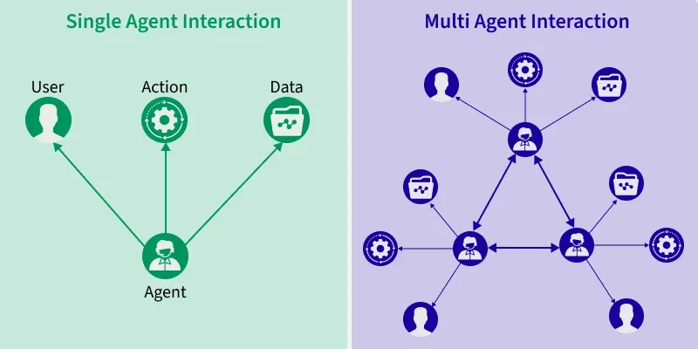
Single Agent System in AI
Single-Agent System Architecture
102

Slide 120
Single Agent System in AI
What is a Single-Agent System?
Strengths 1. Simplicity: Easier to design, develop and deploy compared to multi-agent systems. Requires fewer resources because it does not need to manage multiple agents or communication protocols.
2. Predictability: Easier to debug and monitor because the agent operates independently.
3. Speed: No need for negotiation or consensus-building among multiple agents.
4. Cost: Less expensive to maintain and update compared to complex multi-agent architectures. Fewer integration challenges when deployed in enterprise applications.
103

Slide 121
Single Agent System in AI
What is a Single-Agent System?
Weaknesses 1. Limited scalability: A single agent can become a bottleneck when handling high-volume or complex tasks.
2. Rigidity: Struggles with tasks that require multistep workflows or coordination across different domains.
3. Narrow: Typically designed for a specific function or domain.
104

Slide 122
Multi Agent System in AI
What is a Multi-Agent System?
A multi-agent system (MAS) consists of multiple artificial intelligence (AI) agents working collectively to perform tasks on behalf of a user or another system.
These agents have learning, adaptability, and decision-making capabilities, and interact and communicate with each other to achieve shared goals.
They can be homogeneous or heterogeneous and leverage collective intelligence to solve complex problems.
Multiagent systems operate in a multiagent environment, such as a football team working together to win a game.
105

Slide 123
Types of Communication in Multi Agent System in AI
Types of Communication in Multi-Agent System in AI
The communication between the agents in a multiagent environment can be of two types:
Explicit Communication: Explicit communication is a type of communication where the exchange of messages or signals between the agents is done directly through commands, feedback, requests, etc. This type of communication is more precise and efficient but it can be expensive, noisy, and prone to deception.
Implicit Communication: Implicit communication is a type of communication where the exchange of messages or signals between agents is done indirectly through actions and behaviours. The agents observe the environment and the information is inferred. This type of communication is more robust and scalable but it can be inaccurate, incomplete, and can also be confusing.
106

Slide 124
Multi Agent System in AI
Multi Agent System Architecture
A multi-agent system (MAS) is a group of intelligent agents that work together to fix issues that are too complex for a single agent to handle.
This is how it works:
Intelligent agent architecture means each agent can sense, think, and act on its own.
Since the system uses decentralized AI collaboration, there isn't just one person in charge.
The agents work together to make choices and share knowledge.
This setup supports collaborative decision-making in AI, where agents plan and act as a team.
MAS often follow the principles of swarm intelligence systems. In these systems, simple agents follow basic rules to act in smart groups, like birds moving together.
107

Slide 125
Multi Agent System in AI
Multi Agent System Architecture
The main components of Multi-Agent system are
Agents
Environment
Interactions
Communication
Tools
108

Slide 126
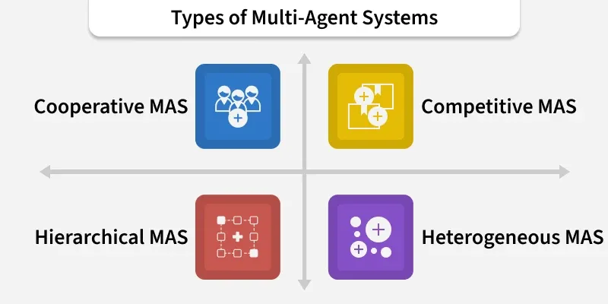
Types of Multi Agent Systems
Types of Multi Agent Systems
109

Slide 127
Types of Multi Agent Systems
1. Cooperative MAS
Agents in these systems work together to achieve a common goal.
They share information and resources to do things that would be hard for a single agent.
Example: Multiple drones conducting a search-and-rescue mission.
2. Competitive MAS
Agents have conflicting goals and compete for limited resources.
Example: In competitive gaming, players (agents) compete to win.
3. Hierarchical MAS
These systems have a structured organization with agents at different levels.
Higher-level agents manage and coordinate lower-level ones.
Example: Mission control systems in space exploration.
4. Heterogeneous MAS
In these systems, agents have different skills or roles which can make the system more flexible and adaptable.
Example: Mixed robot teams (flying drones + ground robots).
110

Slide 128
Multi Agent System in AI
Examples/Applications of Multi Agent Systems
Multi-agent systems (MAS) have transformed different sectors from automobile to healthcare by resolving hard real-world problems. Here's how:
Robotics and Automation: Multiple robots cooperating in warehouses, rescue missions or exploration.
Smart Cities and Traffic Control: Intelligent traffic lights and vehicles coordinating to reduce congestion.
Economics and Trading: Autonomous trading agents in stock markets.
Healthcare: Coordinating hospitals, clinics and patients for resource optimization.
Gaming and Entertainment: Smarter NPCs and dynamic game environments.
Cybersecurity: Intrusion detection systems using distributed agents to monitor networks.
111

Slide 129
Advantages of multi-agent systems
Advantages of MAS
Decentralization: No single point of failure hence becoming robust and resilient.
Scalability: New agents can be added without major redesign.
Flexibility: Handles dynamic and uncertain environments.
Efficiency: Workload can be distributed among multiple agents.
Emergent Intelligence: Complex behavior emerges from simple interaction rules.
112

Slide 130
Difference between a single agent and a multi agent system
Aspect | Multi-Agent System | Single-Agent System
Complexity | More complex due to the need for communication and coordination among agents. | Setting clear goals makes it easier to build and run.
Flexibility | Highly flexible, capable of adapting to changing environments and tasks. | Limited flexibility, best suited for well-defined, static tasks.
Scalability | Easily scalable by adding more agents to the system. | Limited scalability based on the capacity of the single agent.
Performance | Excels in complex, multi-faceted problems requiring collaboration. | Performs well in specific, focused, and narrow-scope tasks.
Best Use Case | Ideal for complex, dynamic, and collaborative environments or tasks. | Ideal for simple, predictable, and cost-sensitive applications.
113

Slide 131
Negotiation and Bargaining in AI
Negotiation
Negotiation is the process of developing intelligent systems or agents that can engage in bargaining or decision making with other agents or systems.
The goal of negotiation in AI is to develop agents that can interact with other agents or systems in a way that maximizes their own objectives.
The outcome is typically represented in terms of allocation of resources (commodities, services, time, money, CPU, etc.).
Agents’ interests are conflicting in the sense that they cannot be simultaneously satisfied, either partially or fully.
Since there are many different possible outcomes, negotiation can be seen as a ―distributed search through a space of potential agreements.
114

Slide 132
Negotiation and Bargaining in AI
Different aspects of Negotiation are
(i) The set of possible outcomes;
(ii) The agents conducting the negotiation;
(iii) The protocol for a specific agreement in this space; and
(iv) The individual strategies that determine the agents’ behavior.
The set of possible outcomes may be represented as a number representing who gets what amount of resource.
The approaches to defining the space of possible outcomes of negotiation are :
1. Task-oriented domains: domains involving the division of tasks to execute.
2. State oriented domains: domains involving joint decision about what state
agents will achieve;
3. Worth-oriented domains: domains involving a joint decision about what goals to
achieve.
115

Slide 133
Negotiation and Bargaining in AI
Negotiation Models
The following are the Negotiation Models
1.Cooperate Negotiation: Agents work together to find a mutually beneficial solution, often aiming for win-win outcomes.
This model emphasizes collaboration and joint problem-solving.
2.Competitive Negotiation: Agents seek to maximize their individual gains, potentially at the expense of others.
3.Mixed-Motivate Negotiation: Combine elements of both cooperative and competitive negotiation. Agents balance between achieving their own goals and working towards a shared solution.
116

Slide 134
Negotiation and Bargaining in AI
What are the five rules of negotiation?
Although different negotiation experts may have their own rules, here are five widely recognized rules of negotiation:
Preparation: Thoroughly research, understand your needs, goals, and the interests of the other party.
Separate the people from the problem: Focus on the issues, not the personalities, to maintain objectivity.
Identify shared interests: Look for common ground and opportunities to create value for both parties.
Generate options: Develop multiple solutions to explore various paths to agreement.
Use objective criteria: Base decisions on fair, mutually agreed-upon standards to ensure fairness and maintain credibility.
117

Slide 135
Negotiation and Bargaining in AI
What are the 4 C's of negotiation?
The 4 C's of negotiation, developed by negotiation expert James K. Sebenius, are:
Context: Understand the circumstances and factors surrounding the negotiation, such as cultural differences, time constraints, and power dynamics.
Conceptualization: Identify the true interests of all parties, avoiding premature judgments or fixation on specific positions.
Collaboration: Work together to explore creative solutions that can address everyone's needs and generate value.
Consequences: Consider the short-term and long-term implications of potential agreements, ensuring they are sustainable and beneficial for all parties.
118

Slide 136
Negotiation and Bargaining in AI
What are the 4 P's of negotiation?
Essentials of negotiation are called P’s of negotiation: They are as follows:
Purpose: Aim is required otherwise it will result in waste of money , manpower and time.
Plan: Main agenda on which negotiation is to be carried on.
Pace: Main points should be covered in discussions also proper breaks must be introduced to maintain interest of people involved.
Personalities: Negotiator initiating negotiation must have convincing power, effective communication skills, can influence people & process of negotiation.
119

Slide 137
Negotiation and Bargaining in AI
Bargaining
Bargaining is the process of discussing and compromising to reach an agreement between two or more parties.
Key Elements: Bargaining often revolves around distributive issues, where the parties are trying to maximize their share of a fixed resource. This can lead to a win-lose scenario, where one party may gain at the expense of the other.
Bargaining Strategies
1. Distributive bargaining
This strategy involves trying to maximize one’s own gain by claiming a large share of fixed resources.
Ex:
In an auction, agents may bid against each other to try to win a specific item.
120

Slide 138
Negotiation and Bargaining in AI
Bargaining Strategies
2.Integrative bargaining
This strategy involves finding ways to create value and expand the available resources so that both parties can benefit.
Ex:
In a negotiation, over a business partnership, agents may seek to identify opportunities for joint ventures or other mutually beneficial projects.
3.Concession-making
This strategy involves making concessions or compromises in order to reach an agreement.
Ex:
One agent may be willing to accept a lower price for a resource in exchange for other benefits.
121

Slide 139
Negotiation and Bargaining in AI
Bargaining Strategies
4.Anchoring
This strategy involves making an extreme initial offer in order to influence to negotiation process.
Ex:
One agent may start with a high bid in an auction in order to set the tone for the rest of the negotiation.
122

Slide 140
Negotiation and Bargaining in AI
Five Powerful Negotiation Rules
Set SMART Goals: Specific, Measurable, Achievable, Relevant, and Time-bound goals guide your negotiation and keep expectations realistic.
Active Listening: Truly understanding the other party's needs and wants helps you find creative solutions that benefit everyone.
Control Your Body Language: Confident posture, eye contact, and open gestures project strength and trustworthiness.
Walk Away With Grace: Knowing your BATNA empowers you to walk away if an agreement isn't favorable, but do so professionally.
Be Ethical: Building trust relies on honesty and integrity. Don't lie, cheat, or pressure the other party.
123

Slide 141
Argumentation among Agents in AI
Argumentation can be defined as an aimed at convincing of the acceptability of a standpoint by putting forward propositions justifying or refusing the standpoint.
Argumentation schemes are forms (or categories) of argument, representing stereotypical ways of drawing inferences form particular patterns of premises to conclusions in a particular domain ( e.g . reasoning about action)
There are below factors involved in argumentation, - Dialectic, implies the structure of argumentation (that is acceptable arguments vs. Fallacies). –
Social psychology indicates agent attitude change and persuasion.
Artificial Intelligence formalize those approaches so as to provide formal theoretical results about particular models.
124

Slide 142
Argumentation among Agents in AI
This will automate agent or multi-agent argumentation capabilities.
For Arguments one needs to reason or provide justifications supporting a conclusion. It is represented as support and conclusion format.
Benefits of Argumentation
Argumentation offers several advantages in the context of AI:
Helps Solve Complex Problems By facilitating communication among agents, argumentation allows for the resolution of complex issues through collaborative input.
Improves Collaboration Between AI Systems Argumentation enhances the ability of AI systems to work together, leading to more cohesive operations.
Makes AI Decisions More Transparent Through argumentation, the decision-making process of AI becomes more transparent, allowing stakeholders to understand the rationale behind decisions.
125

Slide 143
Argumentation among Agents in AI
Why Do Agents Need Argumentation?
Agents require argumentation for several key reasons:
To Collaborate Effectively Argumentation enables agents to work together actively and efficiently, fostering a collaborative environment.
To Resolve Disagreements In any group setting, disagreements are common. Argumentation helps transform these disagreements into agreements through discussion and reasoning.
To Make Better Decisions When faced with a problem, a single agent may struggle to find the best solution. However, when multiple agents collaborate and share their insights, they can arrive at more informed and effective decisions.
126

Slide 144
Argumentation among Agents in AI
Significance of argumentation frameworks in AI
The significance of argumentation frameworks in AI lies in its profound impact on the rationalization and deliberation processes within AI systems.
By providing a structured framework for the assessment of conflicting information and diverse perspectives, it empowers AI to navigate complex decision-making scenarios.
This capability is instrumental in enhancing the robustness and reliability of AI systems, thereby augmenting their potential to effectively engage in critical discourse and reasoning.
127

Slide 145
Argumentation among Agents in AI
How Does Argumentation Work Among Agents?
Argumentation among agents follows a structured process:
Present Claims Each agent shares its opinion and proposed solution regarding a specific problem.
Provide Reasons Agents must explain why they believe their claims are valid, providing reasoning behind their proposed solutions.
Challenge and Support Agents may challenge each other's solutions if they disagree, or they may support a solution if they find it agreeable.
128

Slide 146
Argumentation among Agents in AI
How Does Argumentation Work Among Agents?
4. Evaluate Arguments Agents assess the strengths and weaknesses of the proposed solutions to determine which is the most viable.
5.Reach a Conclusion After evaluating the arguments, agents collectively choose the best solution from the options presented.
129

Slide 147
Trust and Reputation in Multi-Agent Systems
In multi-agent systems (MAS) within artificial intelligence, trust and reputation are mechanisms that enable autonomous agents to make informed decisions, collaborate effectively, and maintain system stability.
Agents build a reputation by interacting with others, and this perceived trustworthiness influences future interactions and collaborations
Trust
Trust is an agent’s belief or confidence in the reliability , integrity or ability of another agent based on past interactions or available evidence. It reflects the agents willingness to rely on or interact with another agent.
Reputation
The collective assessment or evaluation of an agent’s behavior and performance over time. Usually derived from feedback or reports from other agents. It represents how others perceive the agents trustworthiness.
130

Slide 148
Trust and Reputation in Multi-Agent Systems
Trust Models
The following are the Trust Models:
1.Direct Trust: Based on the agent’s own experiences and interactions with another agent. It is typically updated with each interaction, reflecting recent performance.
2.Indirect Trust: Derived from the experiences and options of other agents. This involves :
a) Reputation Systems: Collecting and aggregating feedback from multiple sources to assess an agent’s reputation.
b) Social Networks: Using the trust relationships and endorsements within a network of agents to infer trustworthiness.
3.Contextual Trust: Considers the context or specific situation when evaluating trust.
For example, an agent might trust another agent more in a domain where it has demonstrated expertise.
131

Slide 149
Trust and Reputation in Multi-Agent Systems
Reputation Models
The following are the Reputation Models :
Subjective Reputation: based on the individual opinions or assessments of an agents behavior. This is typically influenced by the reputation of the reporting agents.
Objective Reputation: Based on measurable or observable behaviors and outcomes. This involves tracking performance metrics, compliance with rules or the success rate of interactions.
Aggregated Reputation: Combines multiple sources of reputation information to form a comprehensive assessment. This might involve weighting options from trusted sources more heavily.
132

Slide 150
Trust and Reputation in Multi-Agent Systems
Trust and Reputation Mechanisms
1. Feedback and Rating Systems
Agents provide feedback or ratings on their interactions. These ratings are aggregated to compute an agent’s reputation. For example, in e-commerce platforms , buyers rate sellers , and these ratings influence the sellers reputation.
2. Behavior Monitoring
Tracking and analyzing the behavior of agents over time. An agent’s reputation can be updated based on its compliance with protocols , performance and the results of its interactions.
3. Reputation Aggregation
Techniques to combine multiple reports or feedback sources. This could include averaging ratings, using weighted averages or applying more sophisticated algorithms like Bayesian inference.
133

Slide 151
Trust and Reputation in Multi-Agent Systems
Challenges
Manipulation and Attacks: Agents might attempt to manipulate the trust and reputation system by providing false feedback or colluding with others. Ensuring robustness against such attacks is crucial.
Scalability: Managing and updating trust and reputation information efficiently as the number of agents grows. This involves designing systems that can handle large amounts of data and interactions.
Privacy: Balancing the need for transparency in reputation systems with the privacy of agents. Ensuring that reputation information does not expose sensitive data or violate privacy policies.
Dynamix Environments: Adapting trust and reputation systems to changing environments where agent behavior or the context of interactions might shift over time.
134

Slide 152
Trust and Reputation in Multi-Agent Systems
Design Considerations
Feedback Mechanisms: Design effective feedback systems that allow agents to report and rate others accurately and fairly.
Trust Dynamics: Develop Mechanisms for trust to be updated and adapted based on new information and interactions , reflecting changes in behavior.
Trust Metrics: Choose appropriate metrics for quantifying trust and reputation, such as accuracy , reliability or performance metrics.
Transparency and fairness: Ensure that the trust reputation systems are transparent and fair, providing clear criteria for how trust is assessed and reputation is computed.
135

Slide 153
Trust and Reputation in Multi-Agent Systems
Applications
E-commerce : Trust and reputation systems are widely used to evaluate sellers and buyers , ensuring secure transactions and reliable service delivery.
Collaborative Systems : In Collaborative platforms, trust and reputation help manage and foster cooperation among users or participants.
Autonomous Vehicles: Vehicles in a fleet may use reputation systems to evaluate the reliability of other vehicles and make safe driving decisions based on trust.
Peer-to-peer Networks: Trust and reputation help in file sharing networks or decentralized applications by identifying reliable peers and avoiding malicious ones.
Healthcare: To optimize resource management among various healthcare entities.
Robotics: For multiple robots cooperating in tasks like warehouse operations or rescue missions.
136

